Slide 1






eProtect: An evaluation of electronic filing for DVPO cases in North Carolina
March 2022
SAVIR in Washington DC
Funded by the National Institute of Justice, Grant # 2019-X1584-NC-SI. Points of view in this document are those of the author and do not necessarily represent the official position or policies of the US Department of Justice.
Notes:
Good afternoon, my name is Julie Kafka. I’m a doctoral candidate at UNC Gillings and a research fellow for the UNC Injury and Violence Prevention Research Center. Today I’ll be sharing our findings on the effects electronic filing for domestic violence protective order requests in North Carolina.
This work, what we call the ePrtoect study, was funded by the Department of Justice, Office on Violence Against Women. We have no other disclosures.

Slide 2


Background: Domestic Violence Protective Orders (DVPOs)
Domestic violence (DV): Includes any physical, sexual, or emotional abuse or stalking by an intimate partner or family member
Domestic violence Protective Order (DVPO): Civil restraining order to interrupt abuse
DVPOs are the most widely used legal intervention that directly addresses IPV in the US
Sources:
Benitez et al., 2010; Richards et al., 2018; Bejinariu et al., 2019
Notes:
I’ve provided the definition of domestic violence here for reference.
But for people dealing with domestic violence, one important option it to seek a Domestic Violence Protective Order, or a DVPO. DVPOs are civil restraining orders. This is not managed in criminal courts.
DVPOs are available in all 50 states and are considered the most widely used legal intervention for IPV in the US. DVPOs will often order the respondent to refrain from abusing, harassing, or having contact with the victim, and may include other restrictions as well. Research suggests that these orders are effective at lowering risk of DV-related injury and death.
Just one quick note. In this presentation, you will hear me use the term “victim” instead of “survivor” because that terms are more commonly used in legal settings.

Slide 3
Background: Domestic Violence Protective Orders (DVPOs)
Petitioner (victim) files for DVPO in District Courthouse
24 hours (maximum)
Civil summons issued,
Temporary PO may also be granted
10-14 day
period
Sheriff’s Office serves respondent (abuser)
“Full” DVPO hearing in District Court
Granted
Denied
Voluntarily dismissed
Involuntarily dismissed
Notes:
The DVPO request process varies somewhat state-to-state, but mostly proceeds as follows.
First, the victim submits a DVPO request at their local district courthouse. A judge or magistrate will then schedule a full hearing about 10-14 days out.
At that time, they may also issue a temporary protective order, although those are not the focus of this study. The court will the also issue a civil summons to the alleged abuser, or the respondent. The Sheriff’s Office must then locate the respondent and serve them with this paperwork, making them aware of the date for the full hearing.
During the hearing, the judge will hear testimony, review evidence, and decide whether to issue a full DVPO.
If a DVPO is granted, protection usually last for one year. When the DVPO request is denied, then no formal protection is issued. A case is “voluntarily dismissed” if the petitioner formally rescinds their request for a DVPO, effectively opting out of the process. A case might be “involuntarily dismissed” if the petitioner simply does not attend the full hearing and the judge decides not to proceed.

Slide 4
Background: Domestic Violence Protective Orders (DVPOs)
Barriers to receiving a DVPO:
Victim must go to district courthouse in-person to request DVPO
Must submit DVPO request during working hours
Paperwork in “legalese”
Takes time for sheriff’s office to serve the respondent
Hearing delays
Notes:
I’ve simplified the process, but in practice, obtaining a DVPO can be complicated.
When a victim goes to the courthouse to submit their paperwork, this can compromise their privacy and even safety. You may have heard anecdotally about people being followed to the courthouse or even being confronted by their abuser in the parking lot.
DVPO filing is often only available during prescribed hours, which sometimes means a victim must take time off work or coordinate childcare to arrive within that window of time. And in rural areas, getting to a courthouse may require long driving times.
Also, the paperwork can be confusing or intimidating to a lay person.
Finally, after a victim files their paperwork, the respondent must be notified about the hearing in a timely manner, which does not always happen. Sometimes, the hearing will be delayed to allow more time for the sheriff’s office to track down and serve the respondent.
In some cases, the victim will travel to court numerous times before their case is finally heard.

Slide 5
Innovation: E-filing for DVPOs
eCourts Civil Domestic Violence System (e-filing)
Can request at DV service agency or Family Justice Center instead of traveling to courthouse
Paperwork submitted securely online and triaged to law enforcement for service
May streamline and expedite the DVPO process
Facilitated by an advocate, who can provide emotional support and connect victim to wraparound services
May increase safety for victims, perpetrators, court personnel, and law enforcement
Notes:
To mitigate these barriers, the North Carolina Administrative Office of the Courts launched an innovative electronic filing system for DVPOs.
E-filing allows victims to submit their DVPO request at their local domestic violence service agency or family justice center. A DV advocate will type up the details for their request in a secure online portal, then the electronic paperwork is instantaneously transmitted to the courts and subsequently to law enforcement to help jumpstart service.
By streamlining DVPO requests, e-filing may facilitate faster processing times and decrease burdens on the court system.
Because E-filing is facilitated by a DV advocate, they can provide emotional support while facilitating access to other local services, such as shelters or DV support groups.
For these reasons, e-filing could increase safety for everyone involved, including victims, perpetrators, court personnel, and law enforcement.

Slide 6
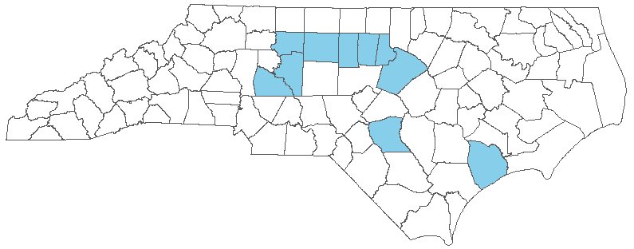
Innovation: E-filing for DVPOs
Goal: Evaluate the effects of e-filing for counties that implemented this innovative practice
As of January 2020, e-filing had been implemented in 10 counties in North Carolina
Note: There are 100 counties total in NC
Notes:
We wanted to examine the impacts of e-filing on key DVPO processes and outcomes.
When we began analysis for this study, e-filing had been implemented in 10 counties across the state, representing a mix of urban and rural settings.
There are 100 total counties in NC, so with 10 already implementing the intervention, that left us with 90 potential comparison counties.

Slide 7


Outcome variables (NC AOC data, 2005-2019)
DVPO disposition rates
Process efficiency
Granted: Rate at which full DVPOs are awarded
Denied: Rate of full DVPO request denied
Voluntarily dismissed: Rate at which petitioners rescind their DVPO request
Involuntarily dismissed: Rate at which petitioner does not attend the full hearing and case is dismissed
Time-to-service: How many days elapse between the initial DVPO request and when the respondent is served
Time-to-outcome: How many days elapse between the initial DVPO request and the conclusion of a case
Notes:
For this study, we used data from the North Carolina Admin Office of the courts to examine the effects of e-filing on case dispositions. Here what I’m talking about is whether, proportionally, more or less cases are granted, denied, or dismissed after counties implemented e-filing. It was important for us to examine ALL these outcomes in case there were unintended effects of the intervention.
We also assessed whether the e-filing expedited the time it took to serve a DVPO, and how much time it took overall for a DVPO request to reach a final disposition. For these efficiency measures, we examined time in DAYS.

Slide 8

Methods
Analysis:
Controlled Interrupted Time Series (CITS) Auto Regressive Integrated Moving Average (ARIMA)
Selected comparison counties based on pre-trends
2 years post-implementation
Notes:
We conducted a controlled interrupted time series analysis (CITS) using autoregressive integrated moving average models.

Slide 9
Choosing comparison group(s)

Slide 10
Involuntarily dismissals
Notes:
To select appropriate comparisons, we examined trends prior to the average implementation date for each outcome and selected counties with pre-trends that were similar to the intervention counties.

Slide 11
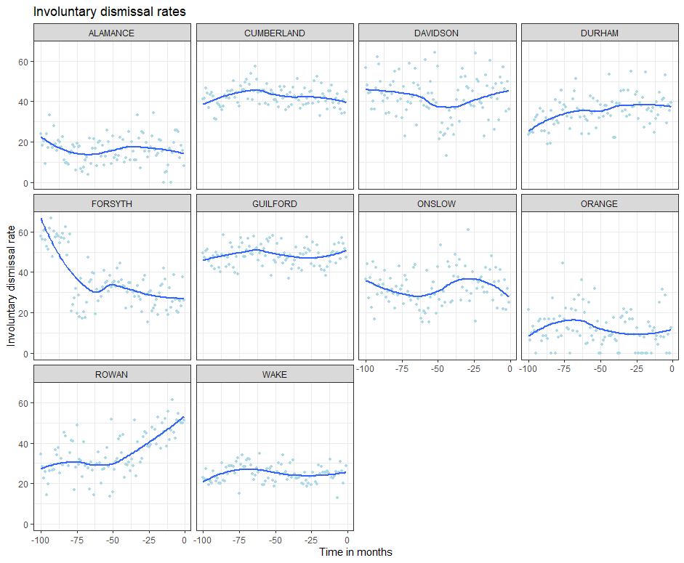
Among intervention counties
(pre-intervention)

Slide 12
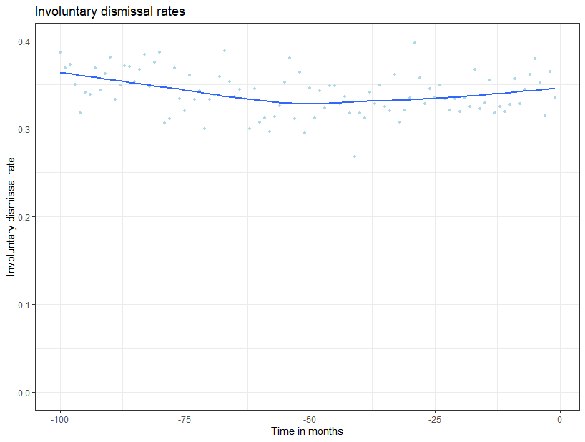
Among intervention counties
(pre-intervention)
Pooled pre-intervention trends

Slide 13
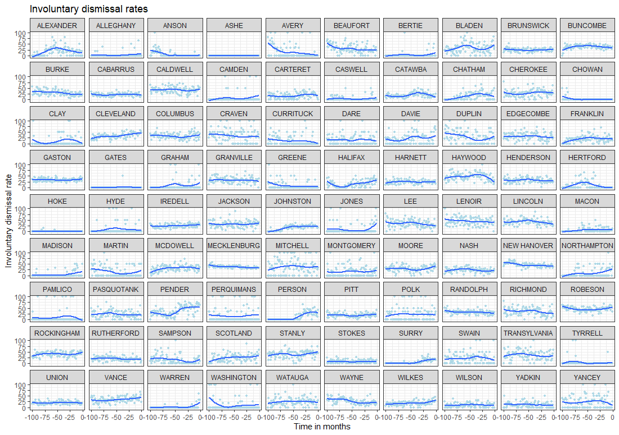

Slide 14
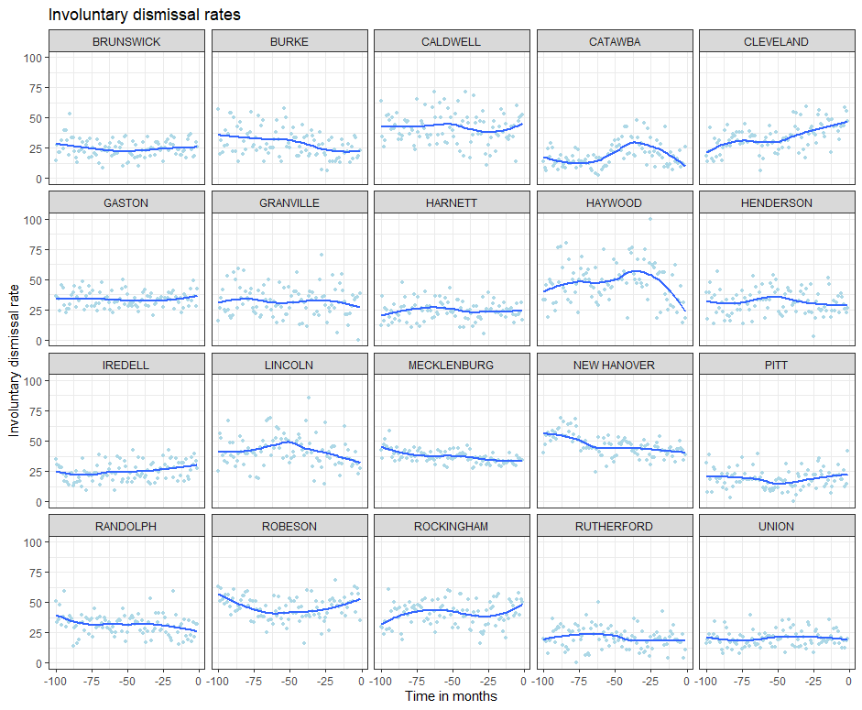
Among comparison counties
(pre-intervention time)

Slide 15
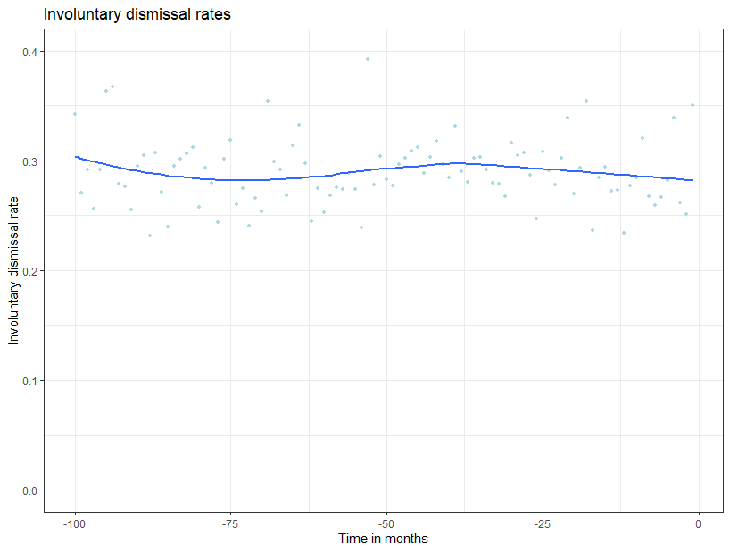
Among pooled intervention counties
Among pooled controls

Slide 16
Setting up CITS ARIMA

Slide 17
Month-Year | Time | Outcome | Policy | Posttime
2018-02 | -4 | 34.6 | 0 | 0
2018-03 | -3 | 33.7 | 0 | 0
2018-04 | -2 | 33.5 | 0 | 0
2018-05 | -1 | 35.3 | 0 | 0
2018-06 | 0 | 34.9 | 0 | 0
2018-07 | 1 | 33.2 | 1 | 1
2018-08 | 2 | 32.1 | 1 | 2
2018-09 | 3 | 34.3 | 1 | 3
2018-10 | 4 | 32.7 | 1 | 4
2018-11 | 5 | 32.5 | 1 | 5
2018-12 | 6 | 33.2 | 1 | 6
…. | … | … | … | …
Single series setup: One row for each pooled time period
Variables:
Outcome
Time: Time counter centered on the intervention date.
Policy: Turns on (0/1) after implementation
Posttime: Turns on after implementation and starts counting up (0/1, 2, 3, 4…)

Slide 18
ITS with comparison : one row for each pooled time period among intervention counties and one row for each pooled time period among control counties
Month-Year | Time | Outcome | Policy | Posttime
2018-04 | -2 | 33.5 | 0 | 0
2018-05 | -1 | 35.3 | 0 | 0
2018-06 | 0 | 34.9 | 0 | 0
2018-07 | 1 | 33.2 | 1 | 1
2018-08 | 2 | 32.1 | 1 | 2
2018-09 | 3 | 34.3 | 1 | 3
…. | … | … | … | …
Group | Grp*Time | Grp*Policy | Grp*posttime
1 | -2 | 0 | 0
1 | -1 | 0 | 0
1 | 0 | 0 | 0
1 | 1 | 1 | 1
1 | 2 | 1 | 2
1 | 3 | 1 | 3
…
0 | 0 | 0 | 0
0 | 0 | 0 | 0
0 | 0 | 0 | 0
0 | 0 | 0 | 0
0 | 0 | 0 | 0
Intervention group
2018-05 | -1 | 36.3 | 0 | 0
2018-06 | 0 | 34.5 | 0 | 0
2018-07 | 1 | 34.9 | 1 | 1
2018-08 | 2 | 35.4 | 1 | 2
2018-09 | 3 | 34.1 | 1 | 3
Control group

Slide 19
Outcomeintervention(i)*group(k)*time(t) = β₀ + β₁*study_time_{t} + β₂*policy_{i} + β₃*postttime_{i*t} + β₄*group_{k} + β₅*group_{k}*time_{t}+ β₆* group_{k} *policy_{i} + β₇ *group_{k}*postttime_{i*t}+ e
Interpreting B Coefficients in ITS with comparison :
Intercept: Existing starting rate in the control group
Study_time: Existing trend (in the control group)
Policy: Post-intervention level change (in the control group)
Posttime: Post-intervention trend change (in the control group)
Group: Existing starting difference (between intervention and control intercept)
Grp*Time: Existing trend difference (between intervention and control groups)
Grp*Policy: Post-intervention immediate change (level change difference between intervention and control groups)
Grp*Posttime: Post-intervention sustained trend change (trend change difference between intervention and control groups)

Slide 20
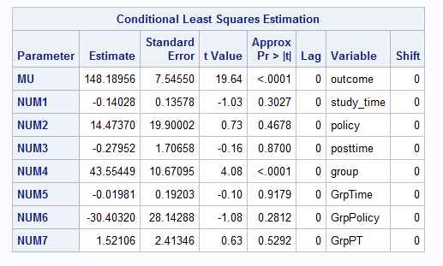
*RUN ARIMA;
PROC ARIMA data= analysis;
identify var= outcome crosscorr=(study_time policy posttime group GrpTime GrpPolicy GrpPT);
estimate input=(study_time policy posttime group GrpTime GrpPolicy GrpPT);
RUN;
Quit;

Slide 21
Results
Notes:
Results are shown based on any change that we observed 2 years after e-filing was implemented.

Slide 22
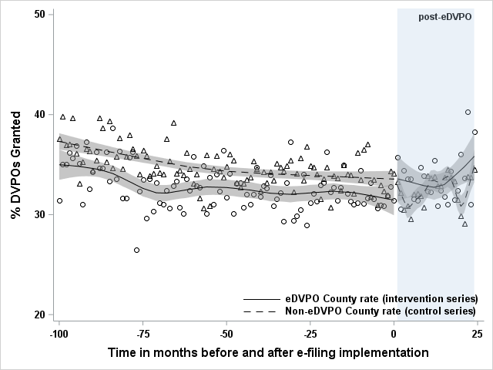
DVPO granting: No significant changes
Immediate change: 2.27 percentage point increase (-0.16, 4.71)
Sustained change: 0.01 percentage point increase (-0.14, 0.17)
Notes:
There were no significant changes in granting rates after e-filing was implemented for intervention counties. Non-significant findings are in grey.
Let me at least walk you through how we might interpret the graph here. The immediate change would be visible here. While we do see a sustained increase in DVPO granting rates for both e-filing and control counties, there was no significant difference when comparing the two groups.
~~~
[Because the rates for comparison counties are so jumpy, that may be why we don’t see an effect, but we would need to examine data over a longer time period to determine that. ]
[having the comparison actually may make us more conservative, but adds methodological rigor]

Slide 23
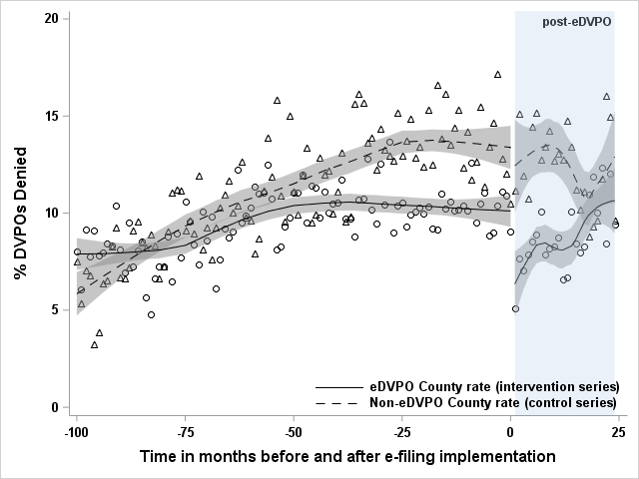
DVPO denials: Immediate decrease, sustained (small) increase
Immediate change: -2.63 percentage point decrease (-4.74, -0.52)*
Sustained change: 0.29 percentage point increase (0.16, 0.43)*
*Significant findings
Notes:
For denials, we did see some significant results, noted with an asterisk. There was an immediate decrease, but a sustained, small increase in denial rates in the long-term for e-filing compared to control counties. Which we think effectively have been a quirk that then corrected itself over time

Slide 24
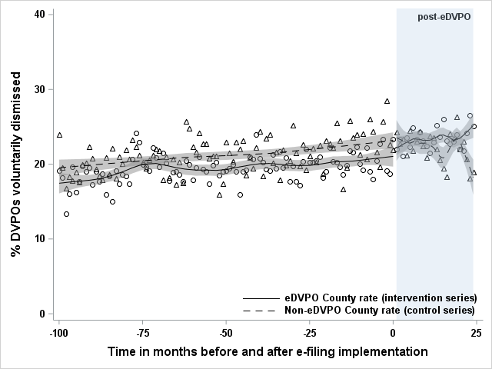
Voluntary dismissals: Sustained (small) increase
Immediate change: 0.96 percentage point increase (-1.51, 3.42)
Sustained change: 0.19 percentage point increase (0.03, 0.35)*
*Significant findings
Notes:
There were no immediate changes for involuntary dismissal rates, but there was a very small sustained increase after e-filing implementation

Slide 25
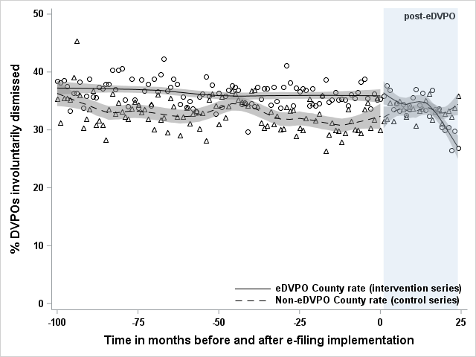
Involuntary dismissals: Sustained decrease
Immediate change: -0.09 percentage point decrease (-2.80, 2.98)
Sustained change: -0.36 percentage point decrease (-0.55, -0.18)*
For e-filing counties, there were 790 fewer involuntary dismissals due to e-filing over the two-year post implementation period
*Significant findings
Notes:
The biggest impacts we saw were in the rates of involuntary dismissals, which we saw go down substantially; this amounts to a decrease of 3.6 involuntary dismissals per 1,000 filed cases per month.
While that does sound small… taken at a systems-level, that means there were nearly 800 fewer involuntary dismissals due to e-filing over the two-year post implementation time period.
____________
Sustained trend – If you just multiplied .36 by 24, then you would only get the difference at the end of the follow-up period. This is a TREND, so need to take into account changes from the previous month, this is a cumulative impact here. So… 24 + 23 + 22 + 21 etc. We’re calculating the shaded area between the counterfactual line and the observed line for the intervention counties.
If the entire state implemented e-filing, we would have approximately 2,880 fewer involuntary dismissals for the first two years after implementation

Slide 26
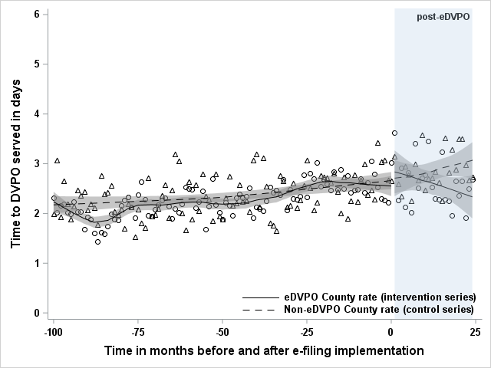
Time to DVPO service: Sustained decrease
Immediate change: 0.13-day increase
(-0.31, 0.58)
Sustained change: -0.04-day decrease (-0.07, -0.01)*
For e-filing counties, this amounted to 12 FTE saved for the court/legal system due to e-filing over the two-year post implementation period
*Significant findings
Notes:
E-filing also led to a sustained decrease in the time it took to serve a DVPO civil summons.
Across the entire post-implementation period, this amounted to 12 FTE worth of time saved for the court/legal system. So it really adds up.
______________
Can’t really sum this up because we used calendar data, rounding to that nearest unit.
0.04 days is not the same as .96 hours. We didn’t measure it fine-grained enough to talk about hours saved.
One person is employed for a year (regardless of how many hours they work!!!) –
12 people would need to be employed for an entire two-year period to keep up with the added work of having no e-filing.
If we save 12,000 person-days, that’s like 16 years of work time saved.

Slide 27
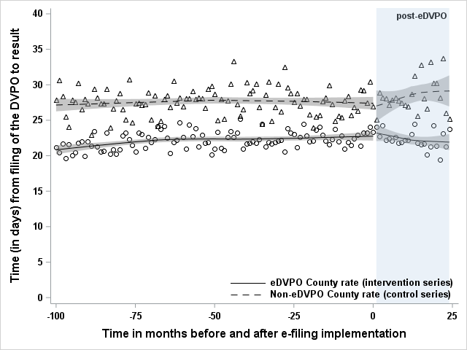
Time to DVPO disposition: Sustained decrease
Immediate change: 0.49-day increase
(-1.62, 2.61)
Sustained change: -0.16-day decrease
(-0.29, -0.02)*
For e-filing counties, this amounted to 48 FTE saved for the court/legal system due to e-filing over the two-year post implementation period
*Significant findings
Notes:
And finally, results showed that e-filing clearly expediated the DVPO process overall.
In total, E-filing saved the court/legal system a total of 48 FTE equivalent time over the two-year period. Which is pretty substantial.

Slide 28

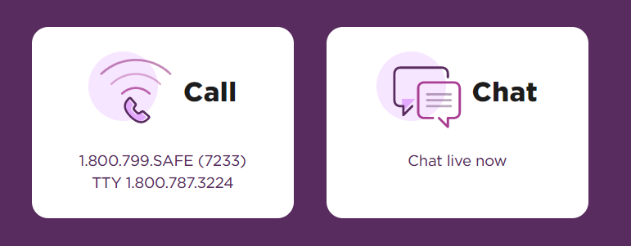
Conclusions: Saving time and serving protection
Funded by the National Institute of Justice, Grant # 2019-X1584-NC-SI. Points of view in this document are those of the author and do not necessarily represent the official position or policies of the US Department of Justice.
DVPO disposition rates
Granting: No significant changes
DVPO denials: Immediate decrease, sustained (small) increase
Voluntary dismissals: Sustained (small) increase
Involuntary dismissals: Sustained decrease
DVPO process efficiency
Time to DVPO service: Sustained decrease
Time to DVPO disposition: Sustained decrease
thehotline.org
Notes:
To summarize…
E-filing does not dramatically change overall granting or denial rates, so justice is being served consistently both before and after this innovation was introduced.
E-filing was associated with decreasing rates in involuntary dismissals which means that more victims of DV get their time in court for a full hearing. We already know that DVPOs can save lives and reduce DV-related injuries and prevent homicide. E-filing increases access to DVPO which is critical.
(While we don’t know exactly why involuntary dismissal rates are decreasing, it is plausible that having an advocate present to help with the DVPO request provides critical guidance, social support, and access to wraparound services that can help victims adhere to their intention to see this process through.)
Our results do clearly show that e-filing helps provide victims with protection faster and can save the court time and money. This is likely because both law enforcement and the courts can manage paperwork more seamlessly, ensuring timely service and follow-up.
And before I conclude the presentation today, I want to say that if you are in distress or you’re worried about a friend or loved one, I encourage you to reach out. You are not in this alone, and there are resources to help you.
Please feel free to contact us with any questions. Thank you for your time and attention today.
___
Counties without e-filing need the equivalent of 48 extra people working in the courts or law enforcement over a two-year period to deal with current case loads. E-filing substantially decreases this burden, which could free up time for personnel to spend time on other important tasks, including taking the time to carefully assess danger in DVPO cases and ensure that victims are receiving all the supports that they need.

